Slide 1
Loading and Examining the Data
Section 1
Notes:
Welcome to the first section of the course.
Loading and examining the data
In the previous volume and sections we had an overview of the course and set up a d3.js development environment.
In this section we will examine the data that we will use for our visualization
Every visualization starts with data, and getting a good understanding of the data is critical

Slide 2
What We’ll Learn
Examining the data in the browser
Loading data from a web server
Overview of the data
Getting familiar with the data that we will use throughout the course
We will examine how the data is represented in chrome with the developer tools and with generated HTML
Loading CSV data in D3.js from a web server
Notes:
In this section we will cover three topics.

Slide 3
What We’ll Learn
Examining the data in the browser
Loading data from a web server
Overview of the data
Getting familiar with the data that we will use throughout the course
We will examine how the data is represented in chrome with the developer tools and with generated HTML
Loading CSV data in D3.js from a web server
Notes:
[Mandatory Slide]
This is a sort of a road map to get introduced to the topics of the section and their title. Instead of putting them as straight bullets, we can show a learning path.

Slide 4
What We’ll Learn
Examining the data in the browser
Loading data from a web server
Overview of the data
Getting familiar with the data that we will use throughout the course
We will examine how the data is represented in chrome with the developer tools and with generated HTML
Loading CSV data in D3.js from a web server
Notes:
[Mandatory Slide]
This is a sort of a road map to get introduced to the topics of the section and their title. Instead of putting them as straight bullets, we can show a learning path.

Slide 5
What We’ll Learn
Examining the data in the browser
Loading data from a web server
Overview of the data
Getting familiar with the data that we will use throughout the course
We will examine how the data is represented in chrome with the developer tools and with generated HTML
Loading CSV data in D3.js from a web server
Notes:
[Mandatory Slide]
This is a sort of a road map to get introduced to the topics of the section and their title. Instead of putting them as straight bullets, we can show a learning path.

Slide 6
Next Video
Overview of the Data
Notes:
[Mandatory Slide]
Here the name of the next video needs to be mentioned. The narration as you guessed it would be just letting the viewer know exactly where we are at and what we’d be taking over next! ☺

Slide 7
Overview of the Data
Video 1.1
Notes:
Welcome to Section 1 of the course. In the previous section we got an introduction to the course and set up a development environment.
Now we start working with real data and creating visualizations with d3.js from that data

Slide 8
In this video, we are going to take a look at…
An quick introduction to bl.ocks.org
See an example of this data in action on D3byEX’s bl.ocks.org ex 7.8
The World Bank pages for the source of our data
Saving the data as CSV locally and examining its content
Review of the merged / cleaned form of the data
Notes:
This slide, like mentioned above is for multiple pointers. The information above covers the types of information that can be used in this slide

Slide 9
References
D3byEX bl.ocks.org: https://bl.ocks.org/d3byex
Example 7.8 from D3.js by Example: http://bl.ocks.org/d3byex/49cd19389a65685808d1
World bank life expectancy page: http://data.worldbank.org/indicator/SP.DYN.LE00.IN
World bank fertility rate: https://data.worldbank.org/indicator/SP.DYN.TFRT.IN
World bank life population: https://data.worldbank.org/indicator/SP.POP.TOTL
Notes:
This slide, like mentioned above is for multiple pointers. The information above covers the types of information that can be used in this slide

Slide 10
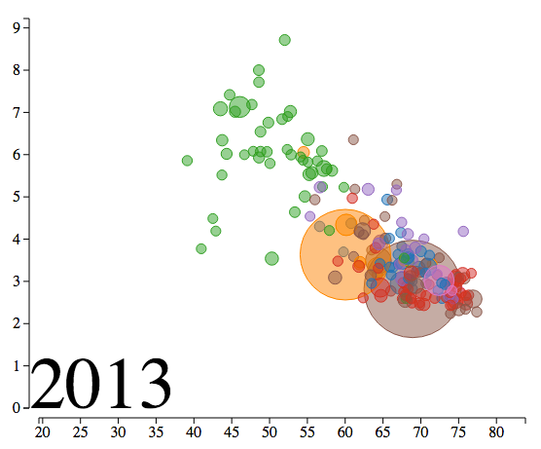
Why this data?
Life expectancy in years (x)
Fertility rate (y)
Population (bubble size)
Region (bubble color)
And time (through animation)
Notes:
This is a single point slide which can be used for multiple purposes.
Use 1 [Mandatory Slide]:
Before the start of the video, we’d like to highlight what are important topics or pointers that we’d be covering in this video. This slide would immediately follow the intro/name slide. This would just be say 2-3 points for the viewers to know what they are getting into.
Use 2:
This slide can also be used to cover topics that can be represented by an image/graph etc. Information which is half image/half information type. Like shown in the example above.

Slide 11
Next Video
Loading data from a web server
Notes:
[Mandatory Slide]
Here the name of the next video needs to be mentioned. The narration as you guessed it would be just letting the viewer know exactly where we are at and what we’d be taking over next! ☺

Slide 12
Loading the Data from a Web Server
Video 1.2
Notes:
[Mandatory Slide] This would be the introduction slide of the topic that you are covering in this subsection.
When this slide plays, you could talk about the main aim that we’d be covering in this video.

Slide 13
In this video, we are going to take a look at…
Using the capabilities of D3.js to load CSV data
Mapping the raw data to a data model
Notes:
This slide, like mentioned above is for multiple pointers. The information above covers the types of information that can be used in this slide

Slide 14
Next Video
Examining the Data in the Browser
Notes:
[Mandatory Slide]
Here the name of the next video needs to be mentioned. The narration as you guessed it would be just letting the viewer know exactly where we are at and what we’d be taking over next! ☺

Slide 15
Examining the Data in the Browser
Video 1.3
Notes:
[Mandatory Slide] This would be the introduction slide of the topic that you are covering in this subsection.
When this slide plays, you could talk about the main aim that we’d be covering in this video.

Slide 16
In this video, we are going to take a look at…
Creating an HTML <table> with D3.js based upon the data
Selecting / creating HTML elements
Notes:
This slide, like mentioned above is for multiple pointers. The information above covers the types of information that can be used in this slide

Slide 17
Summary
Getting data on the web for a visualization
Used D3.js to read and model CSV data
Create an HTML table using data and D3.js operations
Notes:
This slide, like mentioned above is for multiple pointers. The information above covers the types of information that can be used in this slide

Slide 18
Next Section
Creating Bubbles Base on Data
Notes:
[Mandatory Slide] This would be the introduction slide of the topic that you are covering in this subsection.
When this slide plays, you could talk about the main aim that we’d be covering in this video.

